Slide 1
Major Cities in US

Slide 2
Can you name some major cities in US
1. Washington D.C. 7. Houston
2. New York City 8. San Francisco
3. Chicago 9. Boston
4. Los Angeles 10. Pittsburgh
5. Philadelphia 11. St. Louis
6. Detroit

Slide 3
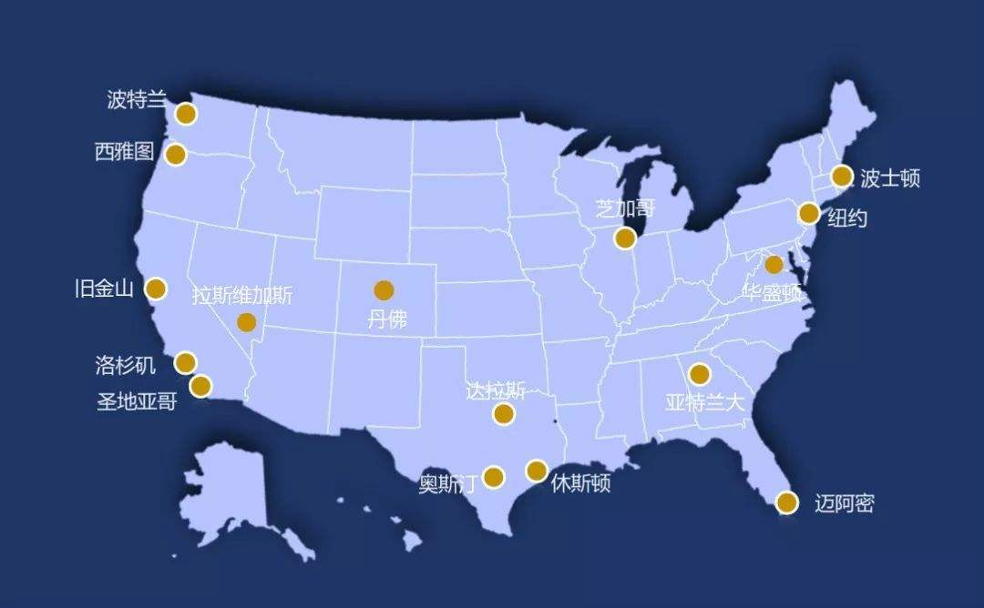

Slide 4
Washington, D.C
Washington, D.C.:the capital of the United States.
D.C.:District of Columbia

Slide 5
带你游览美国首都华盛顿 双字幕 5M very good
https://www.bilibili.com/video/av4825961/?spm_id_from=333.788.videocard.4

Slide 6
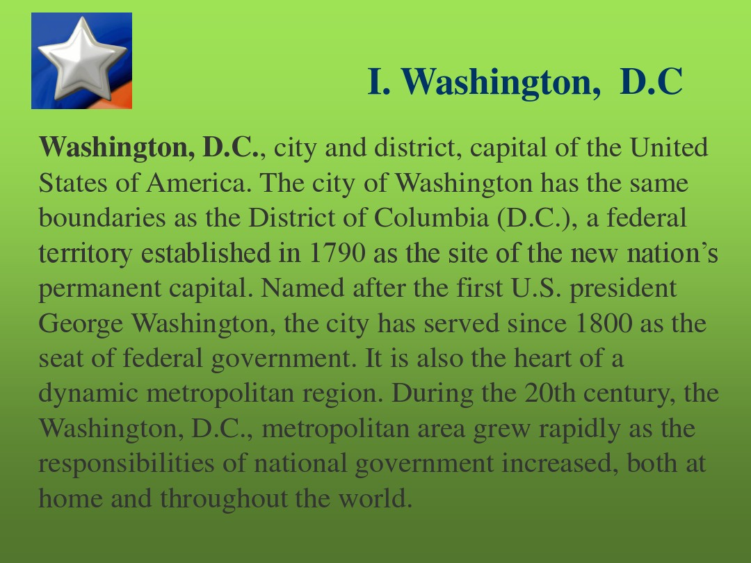
Major Cities
Washington, D.C.:the capital of the United States.
D.C.:District of Columbia
The White House:132 rooms
at 1600 Pennsylvania Avenue
the America’s oldest federal building

Slide 7
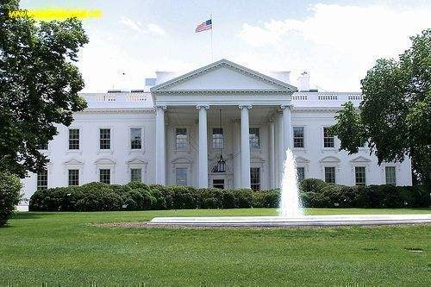
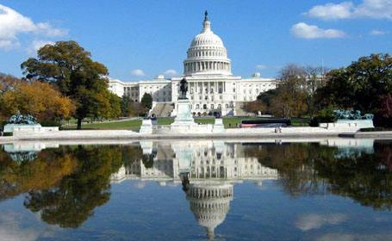

Slide 8
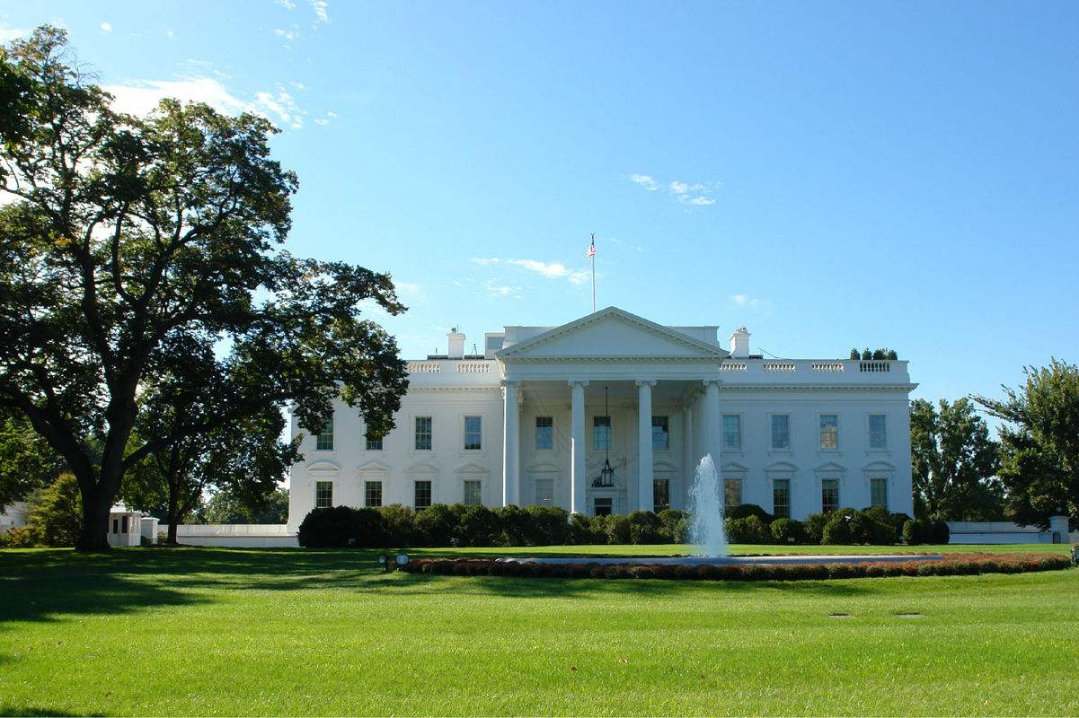

Slide 9
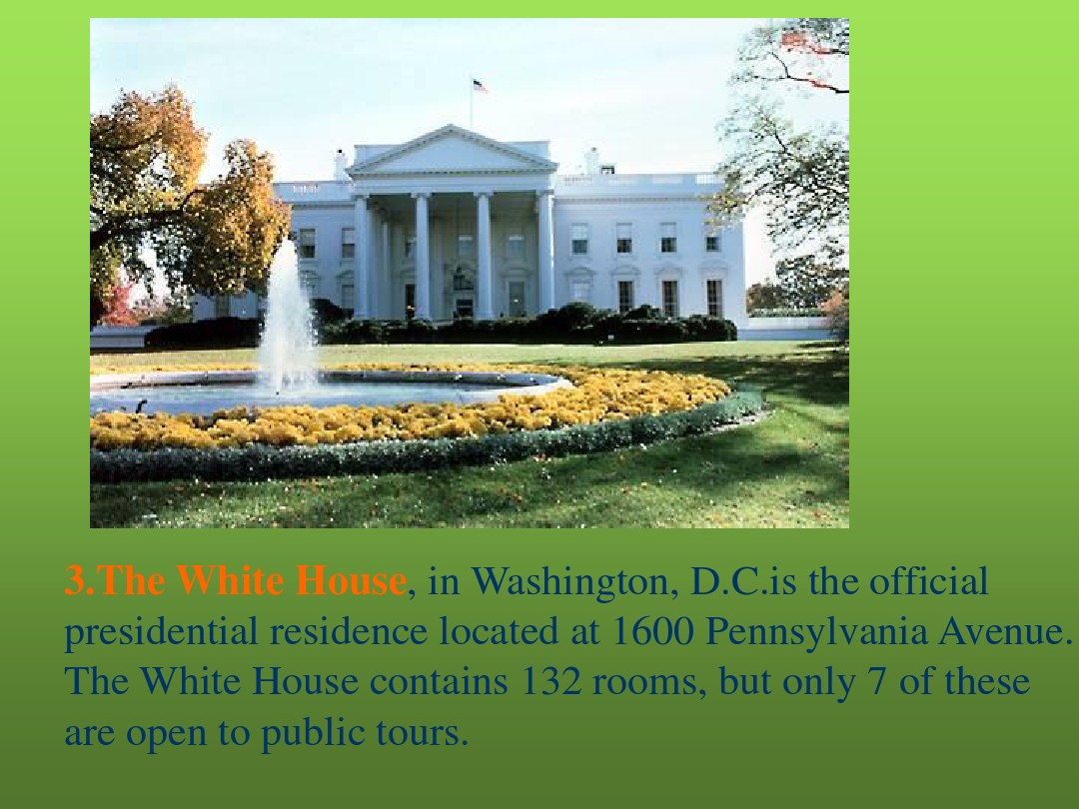
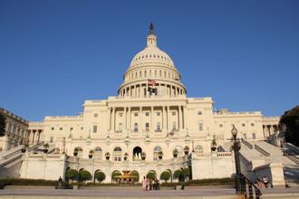
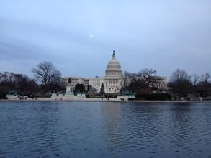

Slide 10
The White House:132 rooms
at 1600 Pennsylvania Avenue
the America’s oldest federal building
George Washington:helped lay the building’s first stone in 1792.
John Adams:the first president to live in the White House.

Slide 11
James Hoban: a Philadelphia architect
Georgian-style gray sandstone building

Slide 13
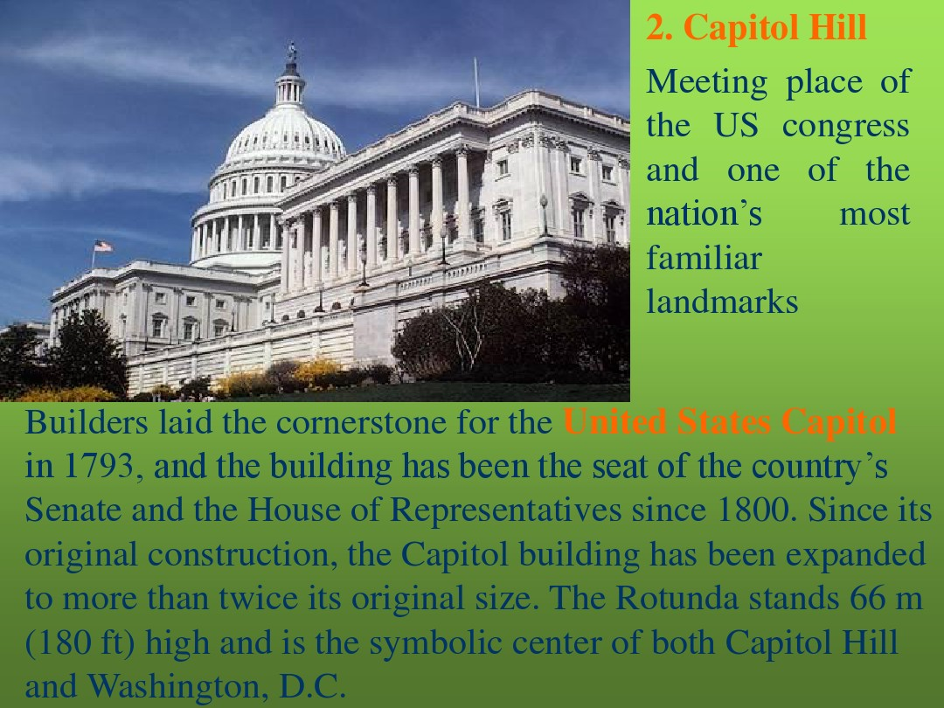
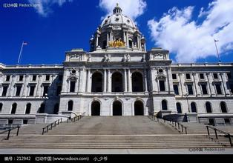
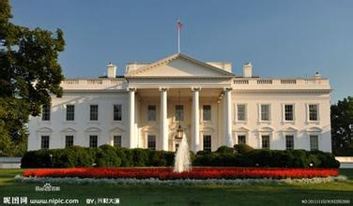

Slide 14
Capitol Hill
located in Washington, D.C
the seat of the U.S. Senate
House of Representatives
George Washington laid the cornerstone for the new Capitol on 18 September 1793

Slide 16
Smithsonian Institution
the largest museum complex in the world
a bequest from British scientist James
Smithson.(1846)
dinosaur bones ,
a zoo full of wild animals
famous paintings

Slide 17
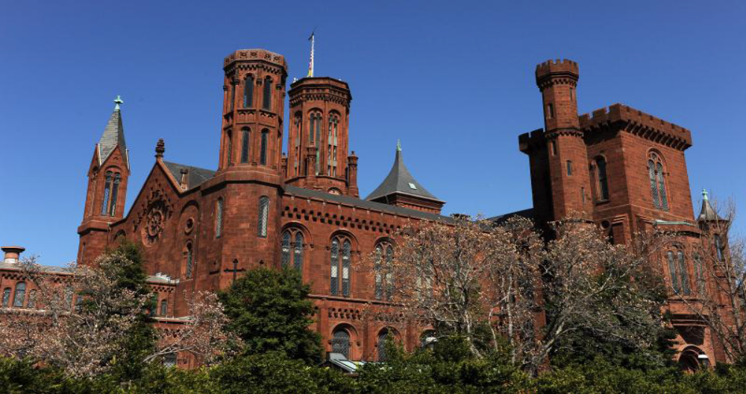
the first airplane: The Wright brothers
the command module from Apollo 11

Slide 18
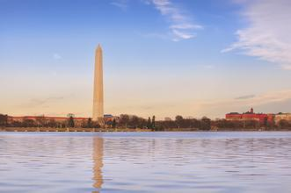
Washington Monument
169 meters high
honor
the memory of
George
Washington.

Slide 19
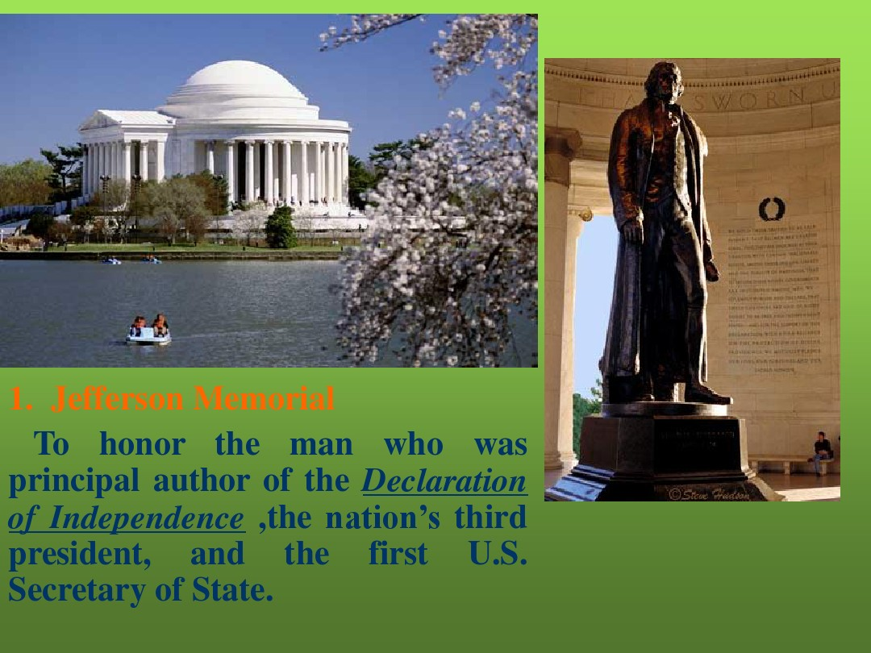

Slide 20
Thomas Jefferson Memorial
completed in 1943,
honorsThomas Jefferson
principal author of the Declaration of Independence
the nation's third president,
the first U.S. Secretary of State.

Slide 21
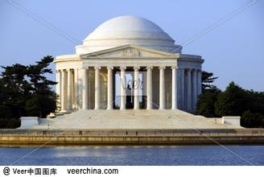
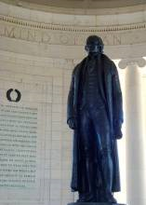
The memorial’s walls:some of Jefferson’s most famous quotations
a bronze statue

Slide 22
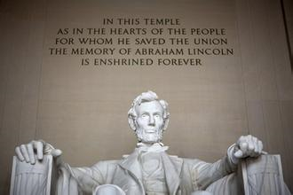
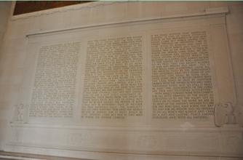
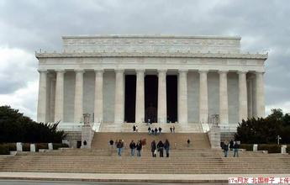
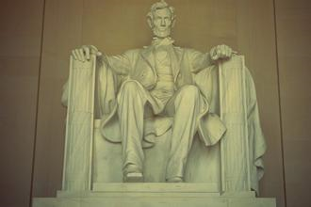
Lincoln Memorial： 16th president

Slide 23
Lincoln Memorial
stands in Potomac Park in Washington, D.C
Gettysburg Address( in 1863) was inscribed on a marble wall
Martin Luther King, Jr
gave his famous “I Have a Dream” speech in1963.

Slide 24
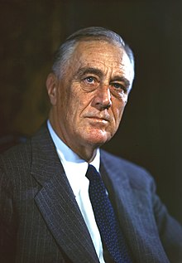
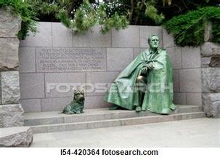
Roosevelt Memorial
the 32nd president
the Great Depression,
World War II
only one statue
of Roosevelt
sitting in a chair
with his faithful
dog:Fala

Slide 25
Roosevelt Memorial
consists of four outdoor rooms with waterfalls, pools, and gardens
A quotation from Roosevelt is engraved on the wall.
the 32nd president of the United States
the Great Depression,World War II

Slide 26
Roosevelt ran successfully for reelection in 1940. His victory made him the only U.S. President to serve for more than two terms. With World War II looming after 1938, Roosevelt gave strong diplomatic and financial support to China as well as the United Kingdom and the Soviet Union while the U.S. remained officially neutral.

Slide 27
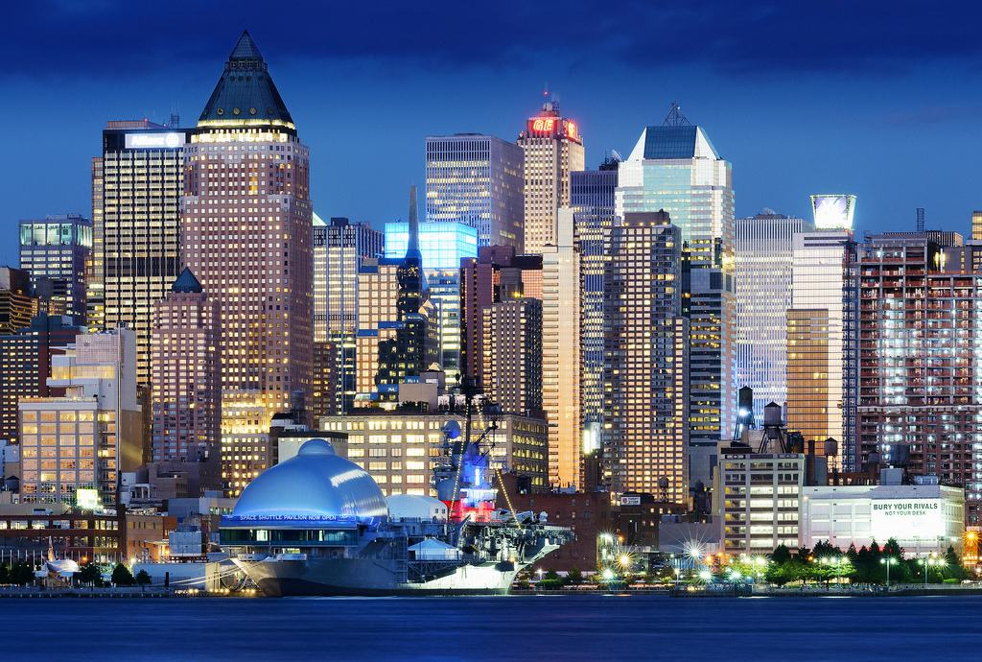

Slide 28
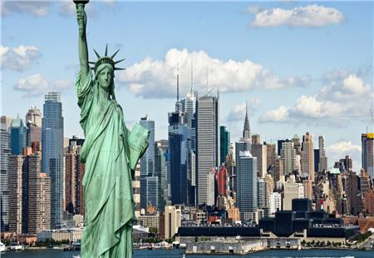

Slide 29
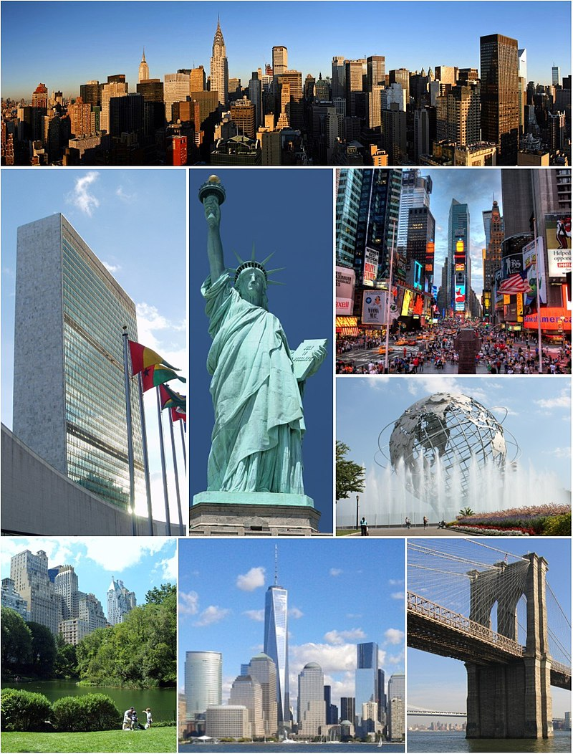

Slide 30
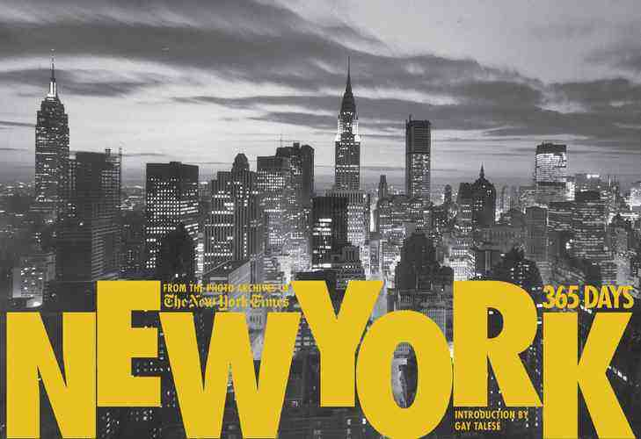

Slide 31
带你游览美国纽约 双字幕6M very good
https://www.bilibili.com/video/av4857219?from=search&seid=7769826325653163803

Slide 33
New York City
A financial,
commercial,
and cultural center
the most populous city in the United States
World metropolis
London, Paris,
Tokyo

Slide 34
国际化超级一线大都市

Slide 35
Location
Located in the state of New York

Slide 36
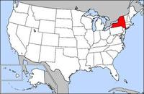
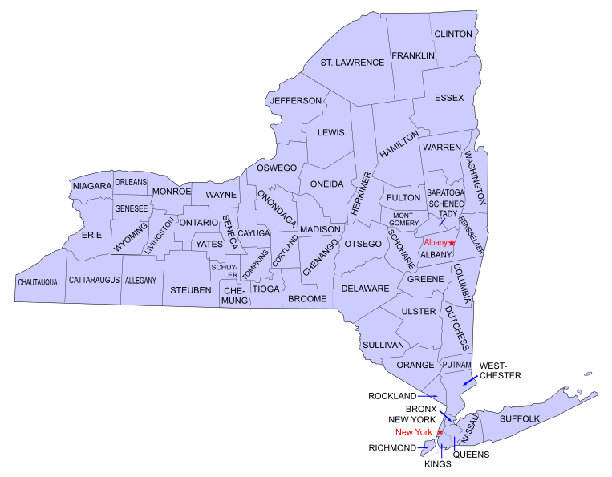

Slide 37
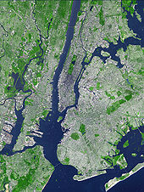
situated on the best American harbor on the Atlantic Ocean
one of the world's largest natural harbors
lies on the Hudson River
five boroughs
Manhattan, Queens, Brooklyn, the Bronx, and Staten Island
the Bronx: the only borough on the mainland

Slide 38
Manhattan (New York County) is the geographically smallest and most densely populated borough; is the symbol of New York City, as home to most of the city's skyscrapers and prominent landmarks, including Times Square and Central Park; and may be locally known simply as The City. Manhattan's (New York County's) population density of 72,033 people per square mile (27,812/km2) in 2015 makes it the highest of any county in the United States and higher than the density of any individual U.S. city. Manhattan is the cultural, administrative, and financial center of New York City and contains the headquarters of many major multinational corporations, the United Nations Headquarters, Wall Street, and a number of important universities, such as Columbia university, New York university, Rocfellor university. Manhattan is often described as the cultural, financial, media, and entertainmentcapital of the world

Slide 39
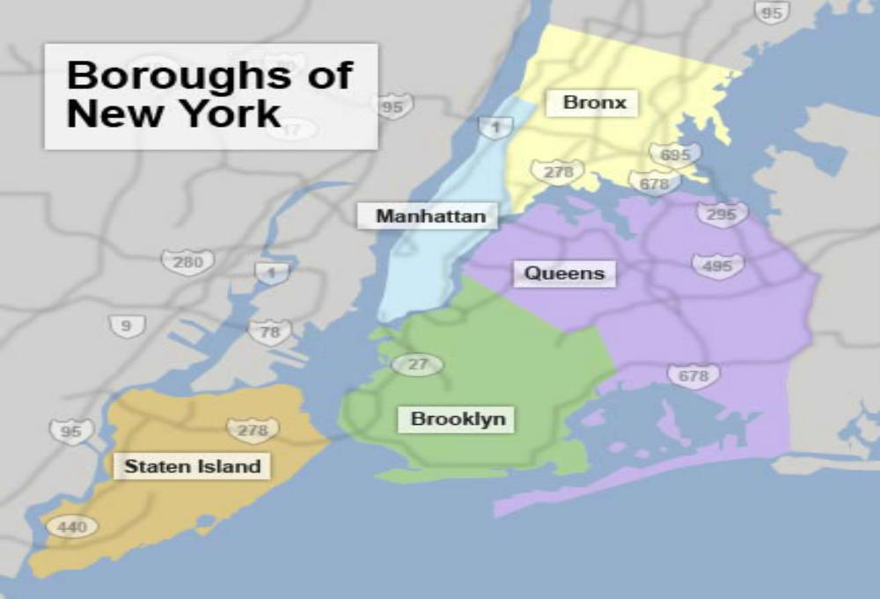

Slide 40
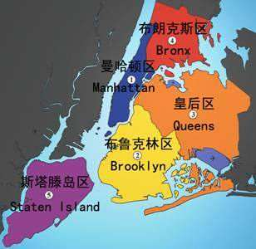

Slide 41
History
Manhattan Island was purchased
from the Indians by Peter Minuit(1626)
New Amsterdam by the Dutch settlers
.renamed New York by the English

Slide 42
cultural, financial, and commercial capital of the world
commerce, entertainment, research, technology, education, politics, tourism, art, fashion, and sports
the most populous city in the United States
the most linguistically diverse city in the world
the most ethnically diverse city in the world
the largest foreign-born population of any city in the world
The Number 1 World Metropolis
home to the world's two largest stock exchanges:the New York Stock Exchange and NASDAQ
have the 12th highest GDP in the world
home to the highest number of billionaires of any city in the world
an important center for international diplomacy
Over 120 colleges and universities, including Columbia University, New York University, and Rockefeller University
Beijing: 92 universities and colleges

Slide 43
A global power city,[18] New York City has been described as the cultural,[19][20][21][22] financial,[23][24] and media capital of the world,[25][26] and exerts a significant impact upon commerce,[24] entertainment, research, technology, education, politics, tourism, art, fashion, and sports. The city's fast pace[27][28][29] has inspired the term New York minute.[30] Home to the headquarters of the United Nations,[31] New York is an important center for international diplomacy.[32][33]
by total market capitalization, the New York Stock Exchange and NASDAQ.[86][87]

Slide 44
Situated on one of the world's largest natural harbors,[34][35] New York City consists of five boroughs, each of which is a separate county of the State of New York.[36] The five boroughs – Brooklyn, Queens, Manhattan, The Bronx, and Staten Island – were consolidated into a single city in 1898.[37] The city and its metropolitan area constitute the premier gateway for legal immigration to the United States.[38] As many as 800 languages are spoken in New York,[39][40][41] making it the most linguistically diverse city in the world.[40][42][43] New York City is home to more than 3.2 million residents born outside the United States,[44] the largest foreign-born population of any city in the world.[45] In 2017, the New York metropolitan area produced a gross metropolitan product (GMP) of US$1.73 trillion.[9] If greater New York City were a sovereign state, it would have the 12th highest GDP in the world.[46] New York is home to the highest number of billionaires of any city in the world.[47]

Slide 45
Many districts and landmarks in New York City are well known, with the city having three of the world's ten most visited tourist attractions in 2013[59] and receiving a record 62.8 million tourists in 2017.[60] Several sources have ranked New York the most photographed city in the world.[61][62] Times Square, iconic as the world's "heart"[63] and its "Crossroads",[64] is the brightly illuminated hub of the Broadway Theater District,[65] one of the world's busiest pedestrian intersections,[66][67] and a major center of the world's entertainment industry.[68]The names of many of the city's landmarks, skyscrapers,[69] and parks are known around the world. Manhattan's real estate market is among the most expensive in the world.[70][71] New York is home to the largest ethnic Chinese population outside of Asia,[72][73] with multiple signature Chinatowns developing across the city.[74][75][76] Providing continuous 24/7 service,[77] the New York City Subway is the largest single-operator rapid transit system worldwide, with 472 rail stations.[78][79][80] Over 120 colleges and universities are located in New York City, including Columbia University, New York University, and Rockefeller University, which have been ranked among the top universities in the world.[81][82] Anchored by Wall Street in the Financial District of Lower Manhattan, New York has been called both the most economically powerful city and the leading financial center of the world,[24][83][84][85] and the city is home to the world's two largest stock exchanges

Slide 46
Today, more than 8 million New Yorkers live in the five boroughs–more than one-third of whom were born outside the United States. Thanks to the city’s diversity and vibrant intellectual life, it remains the cultural capital of the United States.

Slide 47
People
the world’s most ethnically diverse city.
one-third:born in other countries.
famous for its Chinatown
the largest Jewish population of any
city outside Israel

Slide 48
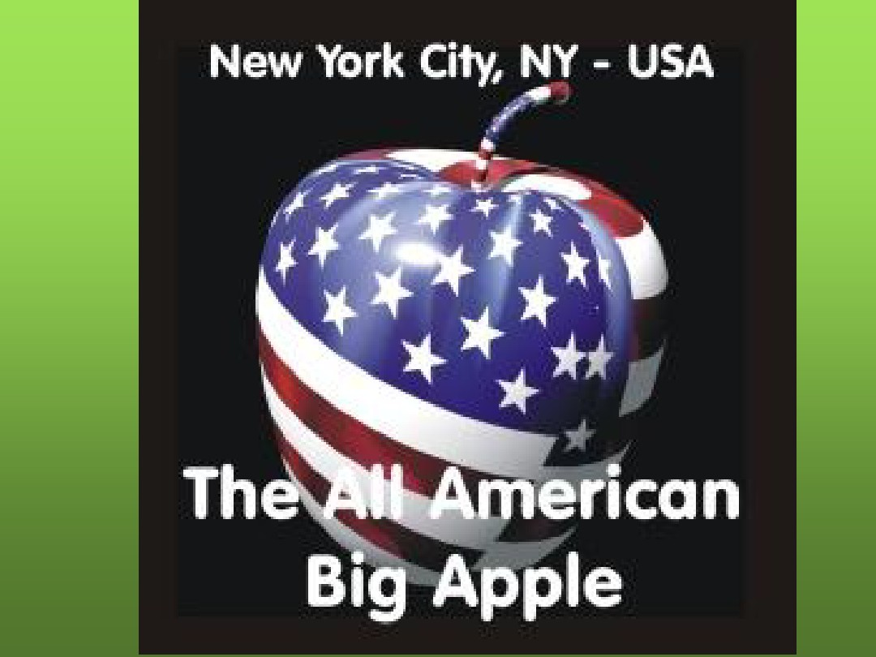
  the ultimate in size, excitement and achievement.

Slide 49
“The Big Apple” means the ultimate in size, excitement and achievement.

Slide 50
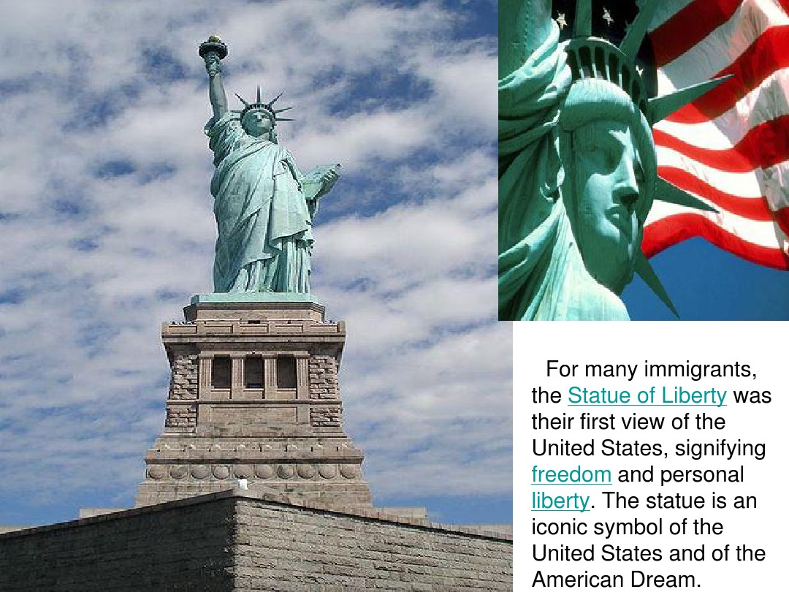

Slide 51
**
For many immigrants, the Statue of Liberty was their first view of the US, signifying freedom and personal liberty. The statue is an iconic symbol of the United States and of American dream

Slide 52
The Statue of Liberty
Standing on Staten Island in New York Harbor
a universal symbol of
freedom and democracy

Slide 53
EnzoLee李恩佐英文频道：Statue of Liberty For Kids - Social Studies Lesson Video 2:11开始介绍 good
https://www.bilibili.com/video/av23997292?from=search&seid=8545632568959454968
【Reactions】自由女神像真正的颜色 4M 无字幕
https://www.bilibili.com/video/av11739175?from=search&seid=8545632568959454968

Slide 54
Questions after watching
Who built it?
What is it made of?
What is the color of it ?
a gift of friendship on October 28, 1886
to celebrate the 100th anniversary of American’s independence.

Slide 55
俯瞰美国：各大城市介绍 46M GOOD
https://www.bilibili.com/video/av5394482?spm_id_from=333.338.b_7265636f6d6d656e645f7265706f7274.2
useful parts
1. 01:00-02:36 自由女神
2. 03:25-04:00 中央公园

Slide 56
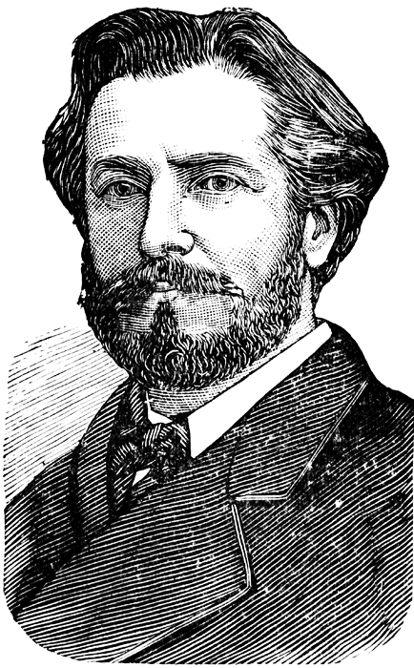
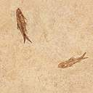
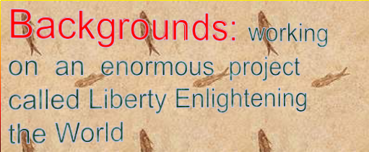
.
they commissioned the renowned sculptor and financing.
Statue of Liberty in France from the political. 1865,
Statue of Liberty in France from the political. 1865,
Statue of Liberty in France from the political. 1865,
Statue of Liberty in France from the political. 1865,
Statue of Liberty in France from the political. 1865,
Designer: French artist Frederic Auguste Bartholdi

Slide 57
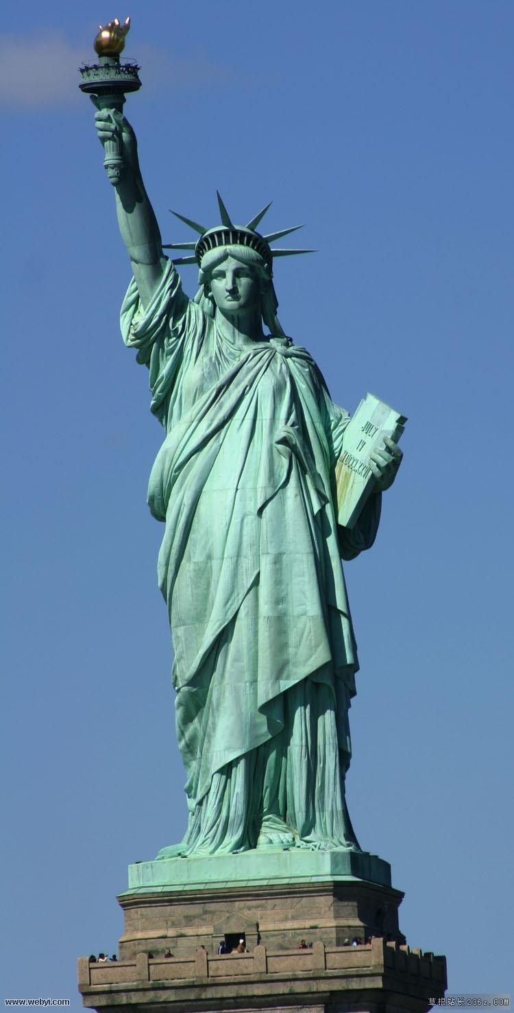
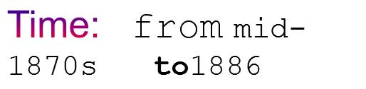
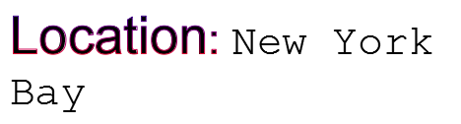
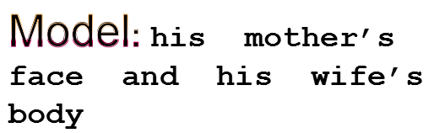
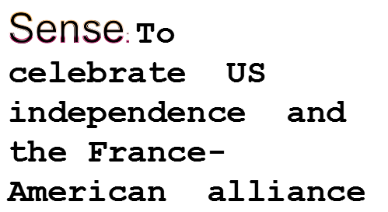

Slide 58
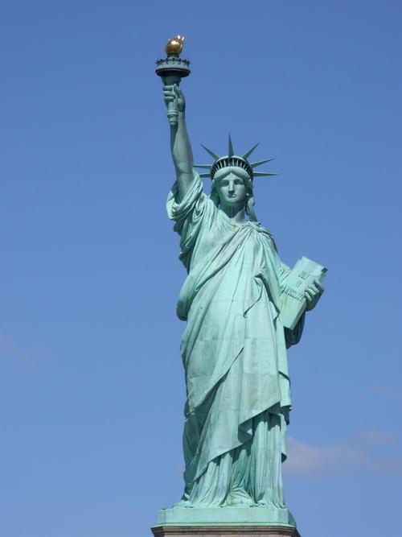
dressed in ancient Greek style of dress,
wearing a crown, the crown has seven sharps.
the symbols of the world's seven continents and four oceans.
Statue of Liberty's right hand hold a torch, the torch up to 12 meters .
The left hand hold "The Declaration of Independence".

Slide 59
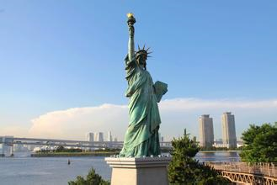
a National Monument in 1924
restored for her centennial on July 4, 1986.
included in the World Heritage List

Slide 60
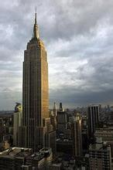
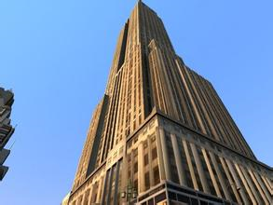
★Landmarks
the Empire
State Building

Slide 61
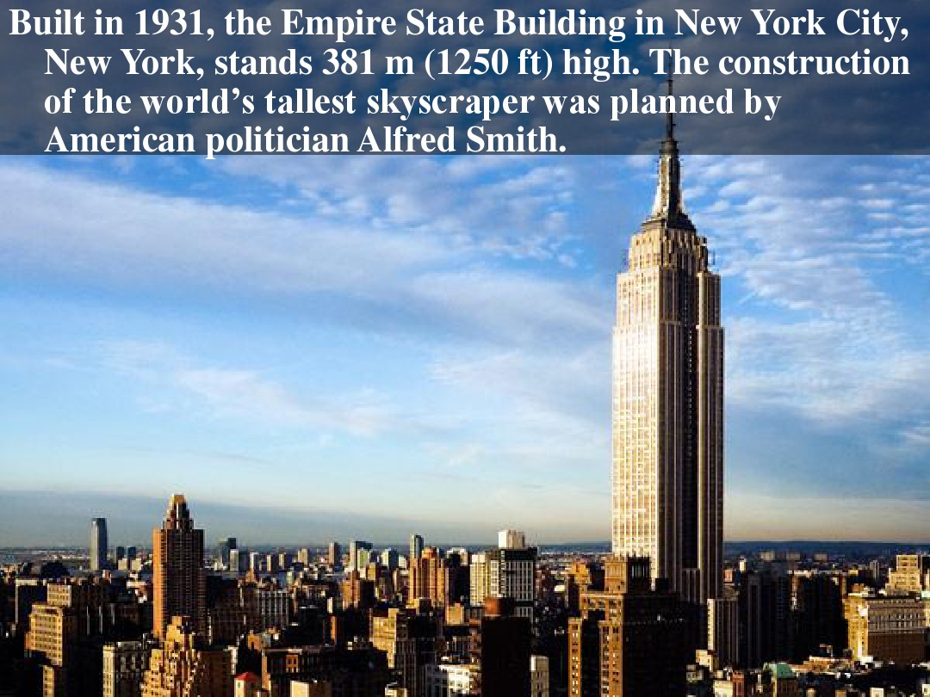

Slide 62
a 102-story landmark
one of the Seven Wonders of the Modern World.
designated as a National Historic Landmark in 1986
ranked number one on the List of
America's Favorite Architecture(2007)

Slide 63
as the world's tallest building for more than forty years,(1931-1972)
the World Trade Center's North Tower（in 1972）
the tallest building in New York City(2001)
the third tallest skyscraper in the America
Chicago's Willis Tower
Trump International Hotel and Tower
15th tallest

Slide 64
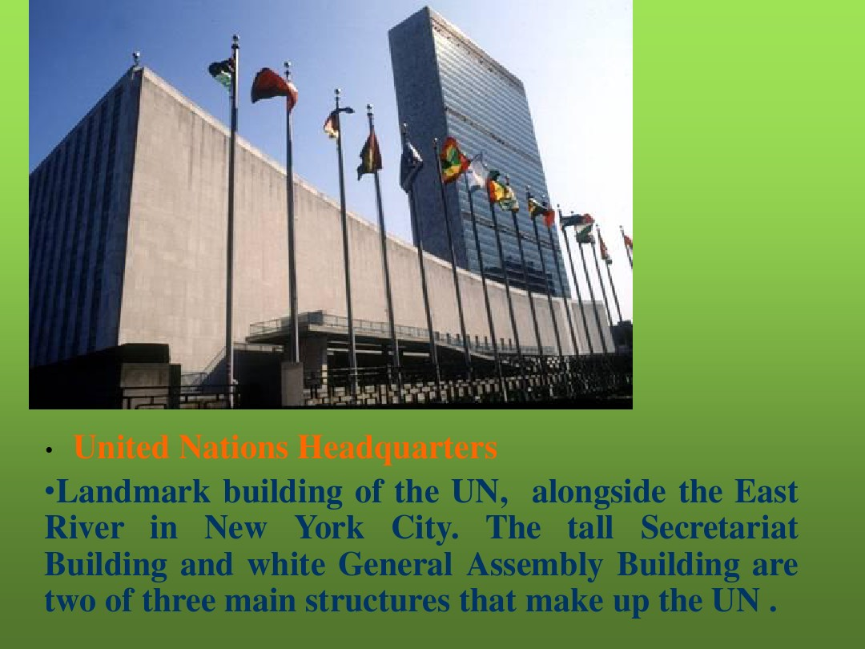

Slide 65
United Nations Headquarters
The landmark buildings of the United Nations
Established in 1945
the UN moved into its NewYork headquarters in the fall of 1952

Slide 66
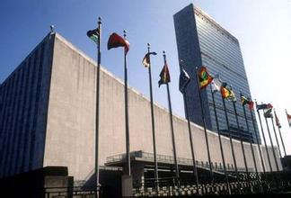
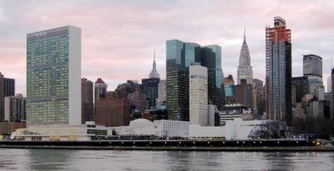

Slide 67
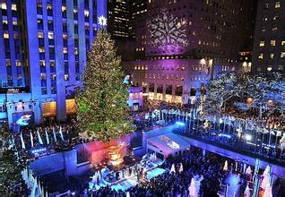
Rockefeller Center
a vast complex of 19 commercial buildings
in the center of Midtown Manhattan
entertainment and shopping center
home to NBC-TV and radio and other media.
a National Historic Landmark in 1987.

Slide 68


Slide 69


Central Park
a large park in the middle of New York City:
designed in 1858
fifth-largest park in New York City
the most visited urban park in the United States
horse-drawn carriages

Slide 70

Panoramic 全景的view of Central Park from Rockefeller Center

Slide 71
Central Park was designed in 1858 Central Park has been a National Historic Landmark since 1962.
Central Park is the fifth-largest park in New York City
Central Park is the most visited urban park in the United States, with 40 million visitors in 2013, and one of the most filmed locations in the world. In terms of area, Central Park is the fifth largest park in New York City, covering 843 acres

Slide 72

The World Trade Center
in the heart of New York City's downtown financial district
the main two towers:
110 stories tall over 410 m high
September 11, 2001

Slide 73


Slide 74

2750 death

Slide 75

The first newbuilding:7 World Trade Center(2006) with 52 stories
rebuilt with six new skyscrapers
a memorial to the casualties of the attacks

Slide 76

一个寻常的九月天，两架被恐怖份子骑劫的客机猛然撞入世贸中心，人们争相从两座大楼仓皇逃走，警长约翰·迈克劳林（尼古拉斯·凯奇 饰）率领的拯救小组却逆向而行，冒死深入灾场展开救援……瞬息间天摇地动，迈克劳林和部下威廉·基米洛（迈克尔·佩纳 饰）来不及反应，已被活埋在千万吨瓦砾之下，呼天不应动弹不得，在地底炼狱中挣扎求生24小时，苦候同胞展开最不可能的拯救行动……

Slide 77
Wall Street
financial
New York’s center,
the leading center for the world
the most economically powerful city
the first permanent home of the New York Stock Exchange,
financial

Slide 78
Anchored by Wall Street, New York City has been called both the most economically powerful city and the leading financial center of the world

Slide 79


Slide 80





Slide 81
Landmark building in Wall Street
Federal Hall,
14 Wall Street (Bankers Trust Company Building),
40 Wall Street (The Trump Building),
the New York Stock Exchange

Slide 82

Federal Hall 联邦厅
1789

Slide 83
1789 George Washington was inaugurated as the first President of the UAS in New York ′ s Federal Hall with John Adams as vice-President.
Federal Hall and Wall Street: the scene of the United States' first presidential inauguration(1789)

Slide 84
1）1788年9月13日，邦联国会暂定纽约为首都。
联邦宪法生效后，1789年3月4日第一届联邦国会在纽约的“联邦厅”开幕；4月30日，华盛顿在纽约的老市政厅宣誓就任第一届美国总统；1790年2月2日，联邦最高法院在纽约的“皇家证券交易所”开庭。至此，新成立的联邦政府的三个机构正式运作起来。
2)1790年，美国迁都宾夕法尼亚州的费城。
3)1800年，美国再次迁都华盛顿。
1789年－1790年，美国国会、总统和最高法院三大机构正式在纽约运作，1800年,美国首都从费城迁到华盛顿

Slide 85

14 Wall Street (Bankers Trust Company Building),
in 1931-33

Slide 86

Trump Building
In 1930
in 1995
the crown jewel
of Wall Street
private residence

Slide 87


Slide 88
川普大楼（特朗普大楼）于1930年建成时称为大通曼哈顿银行大厦，建筑工程只用了十一个月的时间便建成，1995年，川普集团(The Trump Organization)收购了该大厦，并改名为川普大厦(Trump Building)，
这幢经常被当地人称为华尔街王冠宝石的大楼，于1930年一时成为全球最高的大厦，直至同年建成的克莱斯勒大楼(Chrysler Building)所取代。大楼的建筑风格是当时最流行的新古典风格，造形也是当时最常用的建筑格局，底座设计为较大的基座，宏伟的基座是大楼的标志，大楼越高层，建筑立面越修窄，并且梗建造巨大的尖塔顶，这海蓝色的古典尖塔顶十分抢眼 。

Slide 89
由于 Trump 本人的家就在这栋楼的顶层，根据联邦法律，所以这栋楼作为总统私人官邸，也就成为了全纽约 “最安全” 的大楼。Since Trump's home is on the top floor of the building, according to federal law, this building, as the president's private residence, has become the "safest" building in New York.

Slide 90

the New York Stock Exchange
nicknamed
"The Big Board"
Founded in 1792

Slide 91

Broadway Theater District
the epitome 典范of world-class stage talent and entertainment.
is known widely as the heart of the American theatre industry

Slide 92
Broadway Theater District
the epitome of world-class stage talent and entertainment.
a generic term that has grown to include more than just Broadway Street
between 7th and 8th Avenue
Broadway in Manhattan is known widely as the heart of the American theatre industry

Slide 93


Slide 94
Time Square
"The Crossroads of the World",
"The Center of the Universe",
“The heart of the world".
the hub of the Broadway Theater District
a major center of the world's entertainment industry

Slide 95


Slide 96


Time Square:
one of the world's most visited tourist attractions
Approximately 330,000 people pass through it daily
over 460,000 pedestrians walk through Times Square on its busiest days
The busiest pedestrian area

Slide 97
Times Square is a major commercial intersection, tourist destination, entertainment center and neighborhood in the Midtown Manhattan section of New York City at the junction of Broadwayand Seventh Avenue. It stretches from West 42nd to West 47th Streets.[1] Brightly adorned with billboards and advertisements, Times Square is sometimes referred to as "The Crossroads of the World",[2] "The Center of the Universe",[3] "the heart of The Great White Way",[4][5][6] and "the heart of the world".[7] One of the world's busiest pedestrian areas,[8] it is also the hub of the Broadway Theater District[9] and a major center of the world's entertainment industry.[10] Times Square is one of the world's most visited tourist attractions, drawing an estimated 50 million visitors annually.[11] Approximately 330,000 people pass through Times Square daily,[12] many of them tourists,[13] while over 460,000 pedestrians walk through Times Square on its busiest days

Slide 98

Greenwich village was a large residential area, which is located in the west Manhattan, New York. Most of people living there are middle class.

Slide 99
History
In the late of 19th century and the middle of 20th century, Greenwich village was famous for the Bohemianism 波西米亚主义 and the birthplace of Beat Generation.
During the world war I , a good many of bohemians were gradually gathering in this place because of its cheap rents, the reclusive隐居的 atmosphere and even more important---its tolerance for radicalism激进主义 and nonconformity不遵从传统规范; 不认同主流思想.
After the second world war, it became the center for the Beat Generation (垮掉的一代/或称疲惫的一代)(是第二次世界大战之后出现于美国的一群松散结合在一起的年轻诗人和作家的集合体。“垮掉的一代”实际上是“迷惘的一代”的对照。海明威在小说《太阳依旧升起》中塑造了“迷惘的一代”（Lost Generation），这个称谓来自美国著名作家斯泰因为《太阳依旧升起》题的一句辞——“你们是迷惘的一代”“迷惘的一代”指的是第一次世界大战后成长起来的年轻人（包括海明威在内），他们之所以对生活失去信念是由于战争的创伤，但他们并未因此而失去对人性的渴望。“垮掉的一代”则不同，他们中的许多人已经丧失了对人性的最基本的理解，用“垮掉的一代”作为称谓也表达了公众对他们的失望和不满。)

Slide 100
Greenwich Village
in the late 19th – earlier to mid 20th
an artists' heaven, the bohemian capital and the birthplace of the Beat movement
home to upper middle class families.

Slide 101


Greenwich Village

Slide 102


landscapes
Red brick wall and iron stall bar is the most typical buildings in Manhattan 1920s

Slide 103
Fifth Avenue
a symbol of wealthy New York
one of the most expensive and elegant streets in the world.
RENT:$10,226 per square meter per year,
shopping district between 49th and 57th Streets

Slide 104


The Fifth Avenue
a symbol of wealthy New York
one of the most expensive and elegant streets in the world.
RENT:$10,226 per square meter per year,

Slide 105
Constellation of famous buildings and landmarks
Statue of Liberty
Empire State Building
Rockefeller Center
World Trade center
Central Park
United union Headquarter
Wall Street
Time Square
Fifth Avenue
Broadway Street
Federal Hall
New York Stock Exchange
Greenwich village

Slide 106
航拍封城后的纽约“The City That Never Sleep Is Sleeping
https://www.bilibili.com/video/BV1MT4y157S2?from=search&seid=12036105279101022529
瞬间炸裂，美利坚及全球疫情变化图。狗住，各位
https://www.bilibili.com/video/BV1ht4y1m7v2/?spm_id_from=333.788.videocard.0
航拍美国】纽约洛杉矶芝加哥休斯敦《25座城市分P合集》1080Phttps://www.bilibili.com/video/BV1pW411c7Xi/?spm_id_from=333.788.videocard.7

Slide 107

Los Angeles
New York City: 8 million population
L.A.: 3.8 million
Beijing 21.5 million
What do you know about Los Angeles?
the largest city in the state of California
the second largest in the United States
L.A.
the City of Angels
the world's eighth most economically
powerful city by Forbes.com,

Slide 108
1847 to present[edit]
Mexican rule ended during the Mexican–American War: Americans took control from the Californiosafter a series of battles, culminating with the signing of the Treaty of Cahuenga on January 13, 1847.[33]

Slide 109
【双语字幕】带你游览美国加州洛杉矶 双字幕 8M good、https://www.bilibili.com/video/av4883997/?spm_id_from=333.788.videocard.3

Slide 110
洛杉矶是加州的第一大城,也是美国的第二大城[8]，包括5个县，大约1800万人口。洛杉矶在1781年由西班牙创建，1821年后属于墨西哥，1848年墨西哥将加利福尼亚割让给美国。洛杉矶是全世界国际贸易和高等教育中心之一，在大众娱乐诸如电影、电视、音乐方面有着全球领先的地位

Slide 111
founded September 4, 1781 by Spanish governor.
a part of Mexico in 1821
In 1848, becoming part of the United States.

Slide 112

half of the city’s people are Hispanic
one of the largest Chinatowns
Chinese American Museum,

Slide 113

the "Entertainment Capital of the World"
The Hollywood sign is a city landmark.
Beverly
Hills

Slide 114
Entertainment capital of the World
Capital of the movies
The city’s seaport is one of the busiest in the United States
a leading producer of aircraft and
military equipment
an important banking center.

Slide 115


Slide 116


Slide 117


Slide 118
New York VS LA
美国那些事】最大的两个城市对比：纽约市与洛杉矶 中字 11M good
https://www.bilibili.com/video/av35566351/?spm_id_from=333.788.videocard.5

Slide 119

San Francisco
Located in western California on a peninsula between the Pacific Ocean and San Francisco Bay,
A Spanish settlement(1776)
destroyed by a devastating earthquake and fire on April 18, 1906
3000 lives and 28,000 buildings
The city’s Chinatown area:

Slide 120
destroyed by a devastating earthquake and fire on April 18, 1906, which claimed more than 3000 lives and 28,000 buildings. The residents soon rebuilt their city. Estimated at 7.9 on the Richter scale, the earthquake still ranks as one of the largest in world history.

Slide 121
Located in western California on a peninsula between the Pacific Ocean and San Francisco Bay, San Francisco is built on more than 40 hills at the entrance to the bay. Water borders the city on three sides.

Slide 122


Slide 123


Slide 124
带你游览美国加州旧金 双字幕 5M good
https://www.bilibili.com/video/av4815530/?spm_id_from=333.788.videocard.0
旧金山风景3M
https://www.bilibili.com/video/BV1zx411h7kf?from=search&seid=13146267417352771635

Slide 125

Chicago
the third largest city in the United
States.
start in the late 1700s as the dwelling of black trader
Lake of Michigan
1850, busy Great lakes port
important rail hub

Slide 126
Chicago got its start in the late 1700s as the dwelling of black trader Jean Baptiste Point du Sable. The settlement grew because of its location. By 1850, Chicago had become a busy Great Lakes port. As railroads and people moved westward in the second half of the 1800s, the city rapidly developed into an
important rail hub.

Slide 127


Slide 128

Willis Tower

Slide 129

famous for tall buildings
Willis Tower:442 meters,110-story
the tallest building in the world,(1974-1998)

Slide 130
formerly named Sears Tower, is Chicago’s highest skyscraper. From its completion1974 until 1998, it was the tallest building in the world, surpassing the World Trade Center towers in New York, and it held this rank for nearly 25 years.
Willis Tower, formerly named Sears Tower, is Chicago’s highest skyscraper. The 110-story building soars 442 meters into the air. From its completion in 1974 until 1998, it was the tallest building in the world, surpassing the World Trade Center towers in New York, and it held this rank for nearly 25 years. The Willis Tower is the tallest building in the United States and the fifth-tallest freestanding structure in the world, as well as the fifth tallest building in the world to the roof.

Slide 131
a major manufacturing center
a major transportation center
city of blue-collar workers
Chicago’s O’Hare Airport
the busiest airport in the world.
“Hog Butcher to the World”
“The City of the Big Shoulders”
“City of Broad Shoulders ”

Slide 132

“Hog Butcher to the World”世界屠夫

Slide 133
**
Chicago was called Hog Butcher for the World because of its huge meat-processing industry. And, it was called The City of the Big Shoulders or City of Broad Shoulders because of its importance to the nation.

Slide 134
Boston
the capital and largest city of Massachusetts
one of the oldest cities in the United States.
English colonists founded it in
1625

Slide 135
the “cradle” of American independence
a leading city in education.
65 colleges and universities
Harvard and the Massachusetts
Institute of Technology (MIT)

Slide 136
Boston is also one of the oldest cities in the
United States. English colonists founded it in
1625. Because of its excellent harbor on the Atlantic Ocean, the city soon became the busiest port in America.
Boston is sometimes called the “cradle” of
American independence. Many of the events
that led to the American Revolution happened
here. It was a leading center of agitation
against England in the 18th century and a
stronghold of abolitionist thought in the 19th
century.
Boston has always been a leading city in
education. There are more than 65 colleges
and universities in or near the city. Some of
them, such as Harvard and the Massachusetts
Institute of Technology (MIT), are world
famous.

Slide 137


Philadelphia
the largest city of Pennsylvania
the fifth largest in the Untied States
founded as a Quaker colony by Englishman William Penn in 1681
“city of brotherly love.”

Slide 138


Slide 139
the Birthplace of the Nation
Declaration of Independence
The First and Second Continental Congresses
the Constitutional Convention (1787)
the capital of the United States
1790-1800

Slide 140
the name he chose comes from Greek words meaning “city of brotherly love.”
We are standing here in Philadelphia, the city of brotherly love, the birthplace of freedom where the founding fathers authered the Declaration of Independence.
大家现在身在费城。这是个充满手足之谊的城市，是自由的诞生地，是《独立宣言》的诞生地。
It is called the Birthplace of the Nation. The First and Second Continental Congresses
(1774 and 1775-1776) and the Constitutional Convention (1787) met in the city, which served as the capital of the United States from 1790 to 1800 when the government moved to the newly built Washington, D.C.

Slide 141


Independence Hall
the Declaration of Independence
U.S. Constitution

Slide 142
In downtown Philadelphia, visitors can see Independence Hall, where the Declaration of Independence and U.S. Constitution were signed.

Slide 143

the Liberty Bell,
rung after the first reading of
the Declaration of Independence
The University of
Pennsylvania(1740)

Slide 144

Houston
the largest city in southeast Texas
the fourth largest city in the United States.
Founded in 1836
an oil industry center
Space City
The NASA's Lyndon B. Johnson Space Center
美国国家航空航天局

Slide 145
The Lyndon B. Johnson Space Center is located in Houston. It operates the National Aeronautics and Space Administration’s
(NASA) human space flight programs.
林登B约翰逊航天中心位于休斯顿。它负责管理国家航空航天局（美国航天局）人类太空飞行计划。

Slide 146


Slide 147

Detroit
southeastern Michigan
The Motor City
automobile manufacturing industry
Automobile manufacturing center
Home to the Big Three Automobile Company, General Motors, Ford, Chrysler克莱斯勒

Slide 148


Slide 149


Slide 150

Las Vegas
“entertainment city",
"Sin City",
"world gambling city"
"the city of marriage"
a city of southeast Nevada near
the California and Arizona borders
major tourist center known for its casinos赌场
the first state to legalize casino-style gambling

Slide 151
國家地理 超级城市 拉斯维加斯 24M 中文解说
https://www.bilibili.com/video/av61212/?spm_id_from=333.788.videocard.0
纽约 无解说5M（各大城市分集）风景
https://www.bilibili.com/video/av25067706?from=search&seid=5609559223083370214

Slide 152
Summary of Major Cities in USA
Capital
Largest city
Second largest
Third largest
Most powerful city
The Big Apple
“Hog Butcher to the World”
City of Marriage
“The City of the Big Shoulders”
“City of Broad Shoulders ”
Space city
Automobile city
Sin City
City of Angles
city of brotherly love
the “cradle” of
American independence
City of Entertainmnet
Capital of entertainment
Capital of the movies
an important center for international diplomacy
Aircraft manufacturing and military manufacturing
the most linguistically diverse city in the world
the most ethnically diverse city in the world
The leading city in education
the Birthplace of the Nation
Willis Tower
Gambling city
cultural, financial, and commercial capital of the world

Slide 153
纽约：最繁忙的城市 英文讲解 50M
https://www.bilibili.com/bangumi/play/ss32742/?from=search&seid=13049245564794283423
Expedia旅游指南】之纽约（New York City Vacation Travel Guide 英文解说 4M good
https://www.bilibili.com/video/BV1La4y1i7HX?from=search&seid=13049245564794283423
顶尖航拍】美国纽约世贸中心 World Trade Center New York 无解说 4MCityhttps://www.bilibili.com/video/BV1j64y1F7EC?from=search&seid=13049245564794283423

